Slide 1
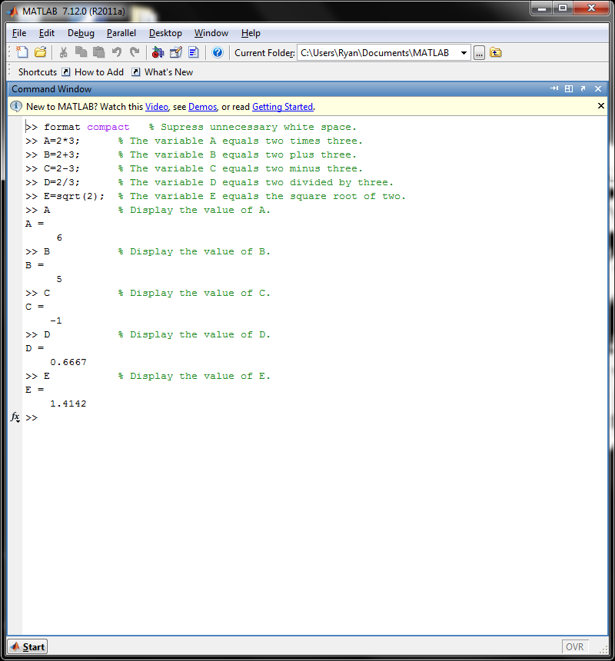
ECE 101 Matlab Assignment #1
Ryan M Fenn
Due September 7, 2011

